Slide 1
Major Depressive Disorder
Lianne Vroom, Shabnam Paiwand, Ashley Carlson

Slide 2
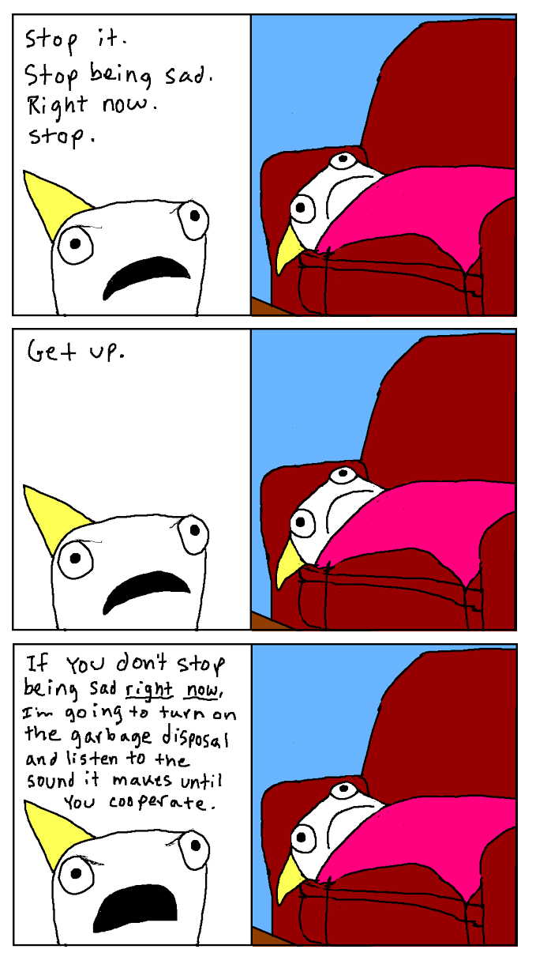
Overview
Depressive Disorders
DSM-IV vs DSM-5
Major Depressive Disorder
What is it?
What to look for?
Risk Factors
Diagnosis
Treatment
Comorbidity
Notes:
une histoire

Slide 3
Depressive Disorders
Major Depressive Disorder
Disruptive Mood Dysregulation Disorder
Persistent Depressive Disorder (dysthymia)
Premenstrual Dysphoric Disorder
Substance/Medication Induced Depression
Depressive Disorder due to another medical condition
Other Specified Depressive Disorder
Unspecified Depressive Disorder
Notes:
LV
In the DSM 5 the disorders under mood disorders include Major Depressive Disorder​ (the subject of this presentation)Disruptive Mood Dysregulation Disorder​, Persistent Depressive Disorder (dysthymia)​, Premenstrual Dysphoric Disorder ​, Substance/Medication Induced Depression, Depressive Disorder due to another medical condition, Other Specified Depressive Disorder​, Unspecified Depressive Disorder​.
The common feature of all of these disorders is the presence of sad, empty, or irritable mood, accompanied by somatic and cognitive changes that significantly affect the individual's capacity to function. What differs among them are issues of duration, timing, or presumed aetiology or causation.

Slide 4
Case Study
Joey is a 10-year-old boy whose mother and teacher have shared their concerns about his irritability and temper tantrums displayed both at home and at school. With little provocation, he bursts into tears, yells, and throws objects. In class, he seems to have difficulty concentrating and seems easily distracted. Increasingly shunned by his peers, he plays by himself at recess- and at home, spends most of his time in his room watching TV. His mother notes that he has been sleeping poorly and has gained 10 pounds over the past couple of months from constant snacking.
Mash, E. M., Berkley, R. A.Eds. (2014)
Notes:
LV
Given this description of Joey, what do you think are some of the symptoms of Major depressive disorder in children?
What types of factors do you think can cause or lead to a child developing depression?

Slide 5
Joey cont.
a deeply unhappy child
expresses feelings of worthlessness and hopelessness and even a wish that he would die.
adverse life experience : symptoms began 6 months ago when his father remarried and moved to another town, where he spends far less time with Joey.
Notes:
A consultation with the school psychologist ruled out learning disabilities or (ADHD); instead, she says, he is a deeply unhappy child who expresses feelings of worthlessness and hopelessness--and even a wish that he would die. These experiences probably began about 6 months ago when his father-divorced from his mother for several years-- remarried and moved to another town, where he spends far less time with Joey.
There are also physical symptoms connected to emotional difficulties including depression, anxiety, headaches, stomach aches, tense muscles, difficulty with sleep and sensitivity to pain. We will discuss the symptoms and causes of depression further now.

Slide 6
What is Major Depressive Disorder? (MDD)
It is a mood disorder that causes persistent feeling of sadness and loss of interest. It affects how you feel, think and behave and can lead to a variety of emotional and physical problems.

Slide 7
DSM-5 Diagnostic Criteria
Five (or more) of the following symptoms have been present during the same 2-week period nearly everyday and represent a change from previous functioning; at least one of the symptoms is either (1) depressed mood (irritable mood) or (2) loss of interest or pleasure.
Depressed mood or irritable
2. Decreased interest of pleasure
3. Significant weight change (5%) or change in appetite
4. Change in sleep
5. Change in activity: Psychomotor agitation or retardation
6. Fatigue or loss of energy
7. Feelings of worthlessness or excessive or inappropriate guilt
8. Concentration or indecisiveness
9. Suicidality
Notes:
(SP) A. At least 5 of these 9, present nearly everyday
NOTE: do not include symptoms that are due to a general medical condition
1. Most of the day, nearly everyday. Example: feels sad, hopeless, empty/ appears tearful -- can be a subjective report or observed by others. Children and adolescents may have difficulty expressing their depressed feelings and complain about feeling “blah”, no feelings, the presence of the depressed mood can be inferred from the persons face and demeanor.
2. In most activities, most of each day. This can be indicated by others observation or a subjective account
3. Change of more than 5% body weight in a month / Note: in children it's important to consider failure to meet expected weight gain.
4. This can be insomnia (not sleeping enough) or hypersomnia (sleeping too much). It’s important to consider how much sleep is required for the child/ adolescences age
ex. 3-6 year old : 10- 12 hours per day
7-12 years old : 10- 11 hours per day
12 – 19 yr. olds: 8-9 hours per day (Reference: WebMD)
5. Psychomotor agitation: fidgeting, pacing-- that is caused from inner feelings of anxiety, restlessness.
psychomotor retardation: Slow speech, slowing down in thought, decreased or slower movement (child may have difficulty getting out of bed, tying his shoelaces, or going down a flight of stairs), slowing down of emotional reactions
This can be observed by others or merely subjective feelings--- usually in children it is observed by teachers, parents, etc
6. Feeling tired, heavy, no energy– child may not want to play sports, finish projects, have social interactions
Thinking that they are useless, or it is always there fault– these thoughts may be delusional
Diminished ability to think or concentrate or more indecisive. Ex. Having trouble deciding what to wear to school everyday – again can be observed by others or subjective
9. Thought of death or suicide, or has suicide plans---children and adolescents may wish not to wake up in the morning or think others are better off without them--- Not just fearing of dying
Tomorrow

Slide 8
B. The symptoms cause clinically significant distress or impairment in social, occupational, or other important areas of functioning
C. The episode is not attributable to the physiological effects of a substance or to another medical condition.
D. The occurrence of the major depressive episode is not better explained by schizophrenia, delusional disorder, or other psychotic disorders.
E. There has never been a manic episode or hypomanic episode.
Note: This exclusion does not apply if the episodes are substance-induced or due to other medical conditions.
Notes:
(SP)
B. For children distress or impairment in school, friends, at home
C. The child/ adolescent is not taking any other medication that may cause these symptoms or suffering from any other medical condition
NOTE: criteria A-C represent a major depressive episode
D. Many overlapping symptoms in MDD and (ex.) schizophrenia such as withdrawal from friends and family, a drop of performance at school, trouble sleeping, lack of motivation

Slide 9
DSM-IV vs DSM-5
"Depressive Disorders" chapter is separated from "Bipolar and Related Disorders"
New Diagnoses of "Disruptive Mood Dysregulation Disorder"
DSM-5 focuses on persistence rather than severity
Irritable mood may be substituted for depressed mood
Notes:
SP
"Depressive Disorders" chapter is separated from "Bipolar and Related Disorders"
New Diagnoses of "Disruptive Mood Dysregulation Disorder" is added to depressive disorders for children to address the issue of potential over diagnoses of Bipolar disorder in children.
DSM-5 focuses on persistence rather than severity (even mild symptoms typical of persistent depressive disorder beginning in childhood commonly predict the envelopment of major depressive episodes.
Because it is recognized that irritable mood is a common expression of depression in young children, the DSM-5 specifies that irritable mood may be substituted for depressed mood

Slide 10
Younger children may:
Older children may:
pretend to be sick
refuse to go to school
cling to parent
worry that a parent may die
sulk
get into trouble at school
be negative or irritable
feel misunderstood
Notes:
(SP)
Signs of depression can be expressed differently in different age groups.
Sulk– complain about everything, lose interest in former hobbies (ex. Complain about social activities they once enjoyed)
Getting trouble at school– child engages in reckless behavior, pushing buttons, engaging in risky behavior (ex. Substance abuse)
Be negative or irritable– child may be short tempered, get angry a lot faster, or aggressive “everything and everyone gets on their nerves”
Feel misunderstood– “nothing will ever get better, no one understands me, there is nothing anyone can do to improve my situation”
These symptoms are seen in most children and adolescents. However, we have to keep in mind that these symptoms happen a lot more frequently, are a lot more severe, and happen more often in children/adolescents with MDD
-- frequent
-severity
-duration

Slide 11
Coding and Recording
Single or recurrent episode
Current severity (mild, moderate, severe)
Psychotic specifiers
Remission specifiers (full, partial)
Other specifiers (without codes)
Example:
F33.1 Major Depressive Disorder, recurrent, moderate severity, with anxious distress
Notes:
The diagnostic code for major depressive disorder is based on whether it is a single or recurrent episode, current severity, presence of psychotic features, and remission status.
Severity
Mild→ few, if any, symptoms in excess of those required to make the diagnosis are present, the intensity of the symptoms is distressing but manageable, and the symptoms result in minor impairment in social or occupational functioning
Severe→ the number of symptoms is substantially in excess of that required to make the diagnosis, the intensity of the symptoms is seriously distressing and unmanageable, and the symptoms markedly interfere with social and occupational functioning.
Moderate→ number of symptoms, intensity of symptoms, and level of impairment is in-between mild and severe.
Psychotic features
This is if delusions and/or hallucinations are present (typically auditory). Most commonly, the content of the delusions or hallucinations is consistent with the depressive themes. Such mood congruent psychotic features include delusions of guilt (e.g., of being
Remission specifiers
Full remission requires a period of at least 2 months in which there are no significant symptoms of depression. There are two ways for the episode to be in Partial Remission: 1) some symptoms of a Major Depressive Episode are still present, but full criteria are no longer met; 2) there are no longer any significant symptoms of a Major Depressive Episode, but the period of remission has been has been less than 2 months. This category can still be used if the patient is receiving treatment to reduce the risk of further episodes. It will be based on the provider’s clinical determination and documentation.
Other Specifiers such as:
With anxious distress- which is experiencing at least 2 symptoms during the current or most recent mood episode. Symptoms include (1) feeling keyed up or tense, (2) feeling unusually restless, (3) difficulty concentrating because of worry, (4) fear that something awful may happen, (5) feeling that you might lose control of him/herself. These specifiers range in severity as well. Mild= 2 symptoms, moderate= 3 symptoms, severe = 4 or 5 symptoms
with mixed features,
with melancholic features→ the specifier with “melancholic features” is applied when an individual is at the depths of a depressive episode. In this state, there is almost no access of capacity for feelings of pleasure. A helpful guideline for determining whether a child or adolecent is in a melancholic state is when they are unable to react emotionally in a way that is expected given the event. Either the mood does not brighten at all, or it brightens only slightly (ex. Up to 20%-40% of normal for only minutes at a time). Individuals exhibit a slower rate and energy level for responding to events. More likely to occur in severe major depressive episodes and occur in those with psychotic features.
with atypical features
Mood congruent psychotic features
Mood- incongruent psychotic features
With catatonia
With season pattern

Slide 12
Diagnosis
Doctor
Mental Health Evaluation
Questionnaires
Rating Scales
Children's Depression Rating Scale (CDRS)
16 items, 6-12 years old
Parent, child and teacher
Notes:
AC - If symptoms of depression in your child have lasted for longer than 6 weeks it is recommended to schedule an appointment with your family doctor and also with a mental health professional. The doctor can help rule out any physical symptoms which may be affecting the childs behaviour. The psychologist will perform a mental health evaluation on the child which includes interviews with the child and the parents/caregivers. The psychologist might also ask for teachers, friends and classmates which are useful in showing consistency among the symptoms and behaviours. Although there are no specific tests - medical or psychological - that can diagnosis depression, using questionnaires and rating scales along with the mental health evaluation can help to accurately diagnose depression in children.
One rating scale often used is the Children's Depression Rating Scale. It is a 16 item measure used to determine the severity of depression in children aged 6 - 12 years. The rating scales are based on responses from parents, teacher and child.

Slide 13
Children's Depression Rating Scale
1. Depressed Mood (0-5). Affect may be aroused (e.g., sad, forlorn, 5. gloomy, anguished) or suppressed. Note nonverbal behavior (e.g., facial expression, eye contact, body posture). Child may or may not verbalize feelings of sadness.
0=No information
1=Definitely not depressed-facial expression and voice animated during interview
2=Doubtful-mild suppression of affect during interview and/or some loss of spontaneity
3=Mild-overall some loss of spontaneity. Child looks unhappy during parts of interview. May still be able to smile when discussing nonthreatening areas
4=Moderate-may have a moderate restriction of affect throughout most of the interview and have brief periods where looks unhappy
5=Severe-child looks sad, withdrawn with little verbal interaction throughout interview. May look like crying
Notes:
AC - Here is an example of a question asked on the Children's Depression Rating Scale.
Source: Trends in Evidence-Based Neuropsychiatry, January/February 2003

Slide 14
Discussion Question:
Who is at risk for developing depression?
Notes:
AC - Who do you think is at greatest risk for developing depression? You can type it in the discussion box.

Slide 15
Who is at Risk for Developing Depression?
Family members
Sex
Negative temperaments
Childhood experiences
Stressful life events
Having few friends or other personal relationships
Other major disorders/medical conditions
Environmental Factors
Notes:
AC - All these factors can increase the risk of a child developing depression.
1. Family members - having relatives with depression increases the possibility of a child within that same family developing depression
2. Not necessarily related directly to children, but woman are more likely to develop depression than men.
3. Having traumatic experiences as a child such as abuse or neglect is more likely to trigger depression.
4. Other stressful life events within the family such as substance abuse, divorce, etc can also contribute to an early onset of depression in children
5. A child who has few friendships
6. A child who has a mental disorder or other serious illness is also at increased risk for developing depression
7. Other environmental factors can also contribute, such as abusing drugs and alcohol, struggles in school, negative home life, loss of a loved one, lack of support from family, etc.

Slide 16
Onset & Prevalence
10-20% of Canadian youth are affected by a mental disorder
5% of males and 12% of females
3.2 million youth in Canada at risk for developing depression
Notes:
AC -
It is estimated that 10-20% of Canadian youth are affected by a mental illness or disorder.
When specifically talking about depression, research indicates that depression onset is occurring earlier in life today than in past decades.
Today, 5% of males and 12% of females aged 12-19 have experienced a major depressive episode.
It is estimated that over 3 million Canadian youth are at risk for developing depression.

Slide 17
Notes:
This model represents the different causes or the etiological influences on depression. It starts with the genetic and environmental vulnerabilities that the child faces from birth. Early adverse experiences could be things like trauma, abuse but are more often problems of family instability. And then genetic factors relate to the heritability of depression and the research is suggesting that there are genetic mechanisms resulting in biological cognitive, emotional and interpersonal vulnerabilities to depression.

Slide 18
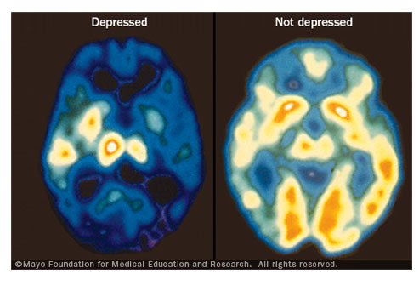
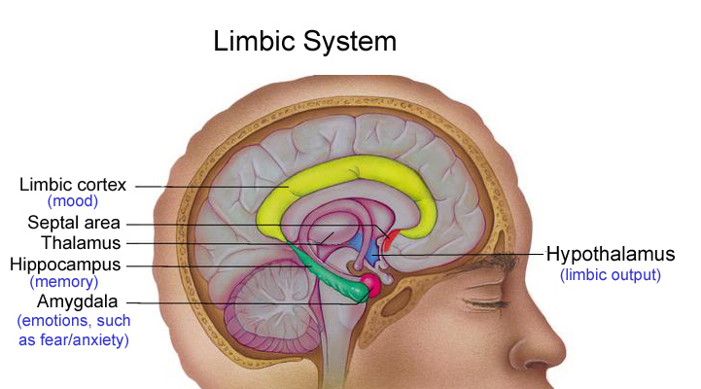
Etiology of Depression: Biological Vulnerability
Reduction in amygdala volume in adults with depression and increased amygdala activation
Lower Hippocampus volume
Notes:
The neural causes of depression have been related to the parts of the brain responsible for emotional regulation. It has been found that there is a reduction in Amygdala volume in adults with depression (not entirely consistent amygdala volume differences in depressed and non depressed children and youth.) As well, Increased amygdala activation has been observed in youth with depression. So, a smaller amygdala = greater activation to negative emotional stimuli.
Another area of the limbic system involved in depression is the Hippocampus which is involved in memory as well as emotional responding. Child and adult studies have found decreased hippocampal volume in individuals with depression.

Slide 19
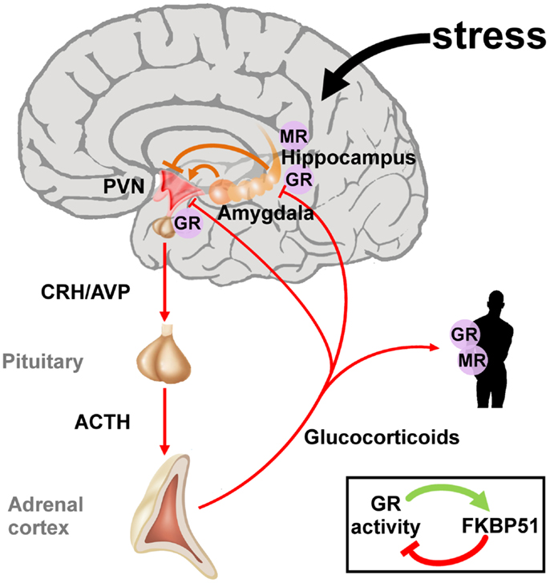
Etiology of Depression: Biological Vulnerability cont.
Dysregulation of the HPA axis (Hypothalamic-Pituitary-Adrenocortical Axis)
Genetics and nature vs nurture
Notes:
A malfunctioning of the HPA axis is one of the most well researched theories for adult depression. It has been theorized that exposure to stressful life events and chronic stressful situations triggers the development of depression in part through the HPA axis.
A malfunctioning of the HPA axis leads to higher levels of cortisol and there is a predictive association between higher cortisol levels and development of depression.
When speaking to the genetic contribution of depression it has been well established that depression runs in families. Heritibility is found to play a more important role in adult depression versus childhood onset depression where heritability is nonsignificant in childhood samples with high rates of environmental contribution. So to date and using twin studies the research shows that it is nurture that is the most indicative of childhood onset depression and genetics play a more substantial role in determining adult onset depression.

Slide 20
Emotional Vulnerability to Depression
Based on temperament
1. High negative emotionality
2. Low positive emotionality
3. Poor effortful control
Notes:
the emotional vulnerability theory to predict depression onset focuses on temperament.
1. High negative emotionality​ - experiencing frequent, intense, long lasting negative affect
2. Low positive emotionality ​- low levels of experiencing positive emotions such as joy and pleasurBased on negative belief systems ​
3. Poor effortful control - difficulty inhibiting undesired impulses and effectively regulation attention

Slide 21
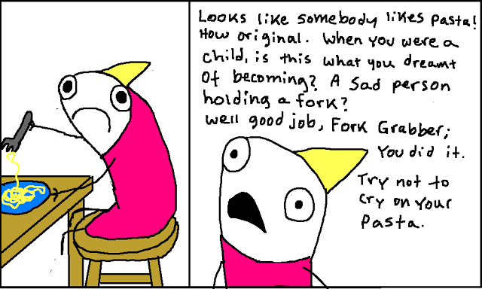
Cognitive Vulnerability to Depression
Based on negative belief system
1. dysfunctional attitudes
2. biases in thinking
3.negative views of the self
Notes:
According to the cognitive Vulnerability theory of developing depression, its the negative belief systems that interact with life stress to predict depression.
1. dysfunctional attitudes- themes of loss, failure or inadequacy,
2. biases in thinking​ - negative automatic thoughts
3. negative views of the self - negative views of the self as worthless or inadequate

Slide 22
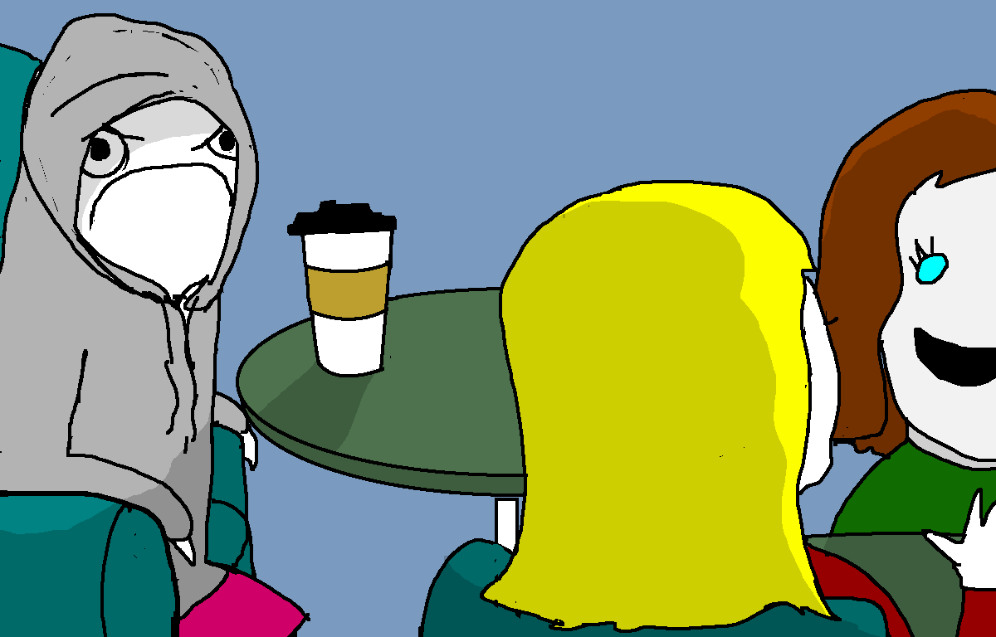
Interpersonal Vulnerability to Depression
More important with regards to children and youth
Impairment in social skills
Relationship disturbances
Notes:
interpersonal vulnerability to depression is more important in regards to child and youth because their social relationships evolve dramatically over the course of their childhood and adolescence.
The interpersonal vulnerability theories for depression state impairment in social skills (excessive reassurance seeking or social withdrawal)
and relationship disturbances like unsupportive parenting and interpersonal stress.
the interpersonal vulnerability theory for depression also focuses on the family environments. Youth who are expressed to unsuportive family environments or maladaptive parenting are at a heightened risk for developing depression and parents of depressed youth are more negative, unsupportive and hostile in parent-child relationships.

Slide 23
Comorbidity
Generalized Anxiety Disorders (GAD)
Panic Disorder
Greater risk for alcohol and substance abuse
Suicidal Risks
Notes:
AC -
Depression is often diagnosed with anxiety disorders such as GAD (Generalized Anxiety Disorder) and panic disorders. Depressed children and adolescents are also at greater risk of alcohol and substance abuse. Children and adolescents with major depressive disorder are also at increased risk of committing suicide, which is the third leading cause of death among youth adults aged 15-24 who have been diagnosed with major depression.

Slide 24
Treatment
Combination of psychological and pharmacological therapies
Psychotherapeutic - Interpersonal Therapy (IPT), Cognitive Behavioural Therapy (CBT)
Pharmacological - Reuptake Inhibitors (SSRI's, SNRI's & NDRI's)
Group Therapy
Family Therapy
http://www.childmind.org/en/posts/articles/2011-5-16-what-behavioral-therapy-works-childhood-depression
Notes:
AC -
A combination of psychological and pharmacological therapies are suggested for those with major depression.
Below is a link to a video that describes some of the therapies used for children with major depression. Watch first, then discuss more.
As discussed in the video, childhood and adolescent depression is often treated with interpersonal therapy (IPT). During therapy, the focus is on the young persons relationship with their peers and family and how they can positively and negatively impact the childs life. IPT encourages children to seek out and participate in activities they've lost interest in. Exercises such as role playing are often used and can help the child understand the activity and the role they can play in making that experience a positive one.
Cognitive behavioural therapy is another common therapy used which teaches children how their thoughts affect their feelings and behaviour. Children are taught that their feelings can have a huge impact on their behaviour and teaches them to see harmful patterns in thought processes. The child is then taught to replace the negative thought processes with positive ones, which ultimately results in better feelings and better behaviour.
Many medications have also proven effective in helping children cope with depression. Medications are usually Reuptake Inhibitors, which increase the supply of neurotransmitters in the brain. These drugs include SSRI's, SNRI's and NDRI's.
Finally, family and group therapy have proven effective for children/youth with major depression. In group therapy, there are multiple patients led by one or more therapists. During session, the group educates themselves regarding depression and interact as a group to improve each others understanding of depression.
In family therapy, the focus is on helping the entire family function in a more positive and constructive way. The main focus in family therapy is patterns of communication within the family system.

Slide 25
Medication as Treatment
Will medication increase the risk of suicide?
- SSRI's proven safe and effective
- Potential benefits vs. Potential risks
Notes:
AC -
A common concern many parents/caregivers have depression, is if medication will increase the childs risk of suicidal thoughts or behaviour.
When prescribed and monitored carefully, medications are a safe and effective way to treat children/youth with MDD. SSRI's are the most commonly used, and the most safe and effective.
Although some antidepressants have been associated with an increase in suicidal thoughts or behaviours, most SSRI's are proven to be effective in helping children and adults live positive, functional lives. As with every treatment, there are potential benefits and potential risks. Benefits include a positive change in the childs everyday mood and functioning, more energy to participate in daily activities, and more motivation throughout the day. General risks, besides suicide for children include lose of appetite, anxiety, trouble sleeping, etc. When a child/youth is suffering from severe depression, the potential benefits from medication treatment seem to outweigh the potential risks.

Slide 26
Is it Sadness or Depression?
Sadness
Depression
normal human emotion
triggered by an event
sad ABOUT something
feeling eventually remits
abnormal emotional state
no specific event
sad about everything
Unable to recover
Notes:
AC - Since depression is often associated with sadness, it is often misunderstood if a person or child is sad or depressed. The terms are sometimes used interchangeably to mean the same thing. It is important to know the difference between being sad and having depression.
Sadness is a normal human emotion. It is usually triggered by a difficult, hurtful or disappointing event, in other words, we are sad ABOUT something. Usually when our emotional hurt fades or something changes, that feeling of sadness remits and we are able to heal.
When a person is depressed this emotional state affects their thinking, emotions and behaviours in an abnormal and chronic way. It is usually not triggered by a specific event, it often occurs in the absence of any particular life event. The person is sad about everything. This is why people might often admit that their lives are completely fine, yet they feel sad towards everything. Since depression affects all aspects of a persons life, they are also less likely to "bounce back" from a depressive state.

Slide 27
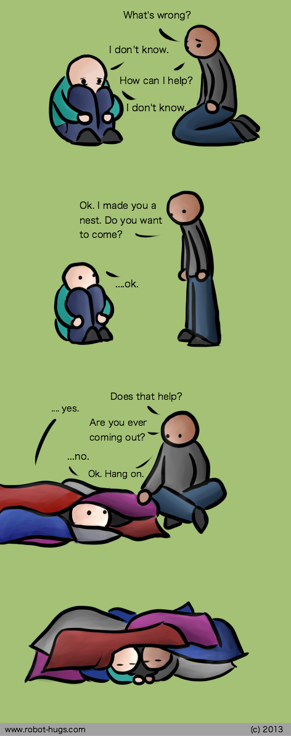
Questions?

Slide 28
References
Depression in children. Depression Health Center. Retrieved from: http://www.wbmd.com/depression/guide/depression-children?page=2#4
Fast facts about mental illness. Canadian Mental Health Association. Retrieved from http://www.cmha.ca/media/fast-facts-about-mental-illness/#.VhlBQbS4l
Major Depressive Disorder. Child Mind Institute Mental Health Guide. Retrieved from http://www.childmind.org/en/health/disorder-guide/major-depressive-disorder
Mash, E.J. & Barkley, R.A. (2014). Child Psychopathology (3rd ed.).New York: Guilford Press
Oppositional defiant disorder resource center. (2015). American Academy of Child & Adolescent Psychiatry. Retrieved from http://www.aacap.org/AACAP/Families_and_Youth/Resource_Centers/Depression_Resource_Center/FAQ.aspx
Poznanski, E., & Mokros, H. (2015). Children's depression rating scale. Retrieved from: http://www.wpspublish.com/store/p/2703/childrens-depression-rating-scale-revised-cdrs-r
Notes:
I've added my references in, will properly site them this week ! - AC

Slide 29
References
Savitz, J., Lucki, I., & Drevets, W. C. (2009). 5-HT1A receptor function in major depressive disorder. Progress in Neurobiology, 88(1), 17-31. retrieved from http://dx.doi.org.ezproxy.lib.ucalgary.ca/10.1016/j.pneurobio.2009.01.009
Winch, G. (2015). This is the difference between sadness and depression. Psychology Today. Retrieved from https://www.psychologytoday.com/blog/the-squeaky-wheel/201510/is-the-difference-between-sadness-and-depression?utm_source=FacebookPost&utm_medium=FBPost&utm_campaign=FBPost

Slide 30
What would you suggest for treatment?
Q: My 8-year-old son is always unwell. In no particular order throughout the day he will be suffering ranging from headaches, tummy aches, pain on different parts of the body. He is very emotional and reactive. I myself have been diagnosed with depression decades ago, so our interactions become quite painful, and leave me feeling spent and guilty. Please help. I do not know how to help my child. He is a very unhappy boy, who told me that he knows I am tired of his complaints, and is feeling rejected at some level, I think.
Notes:
physical symptoms are often connected to emotional difficulties including depression and anxiety. For example, headaches, stomach aches, tense muscles, difficulties with sleep, and sensitivity to pain can be connected to both anxiety and depression.
Because your son has some of these symptoms and there is a family history of depression, my advice would be to pursue a comprehensive psychological assessment with a psychologist. Getting an assessment will help you understand what your son is experiencing ​
With the right diagnosis, your son can get treatment that helps him learn the connection between his thoughts, feelings, and behaviors and provide him with specific coping skills to manage his emotional reactivity and help him feel more in control of his experience

