Slide 1
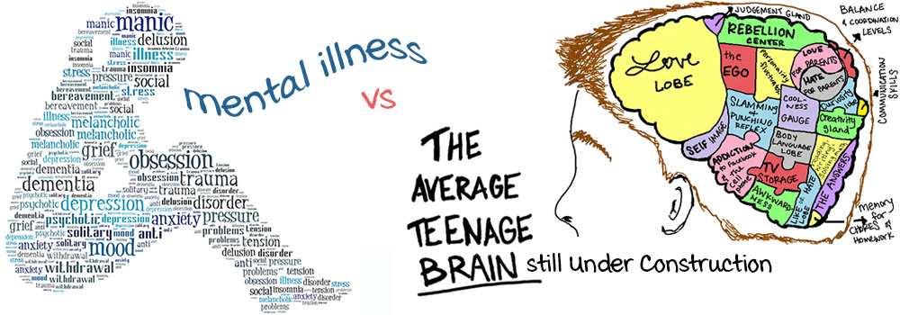
Adolescence

Slide 2
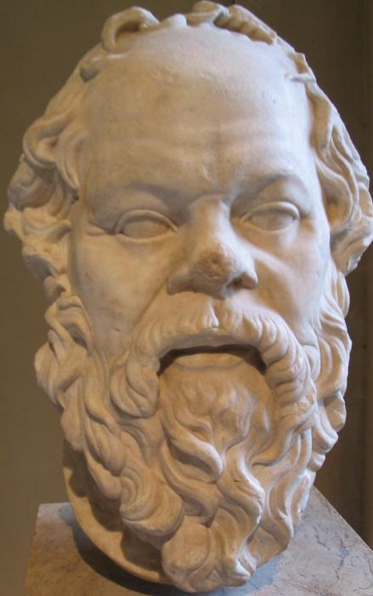
Our youth now love luxury. They have bad manners, contempt for authority; they show disrespect for their elders and love chatter in place of exercise; they no longer rise when elders enter the room; they contradict their parents, chatter before company; gobble up their food and tyrannize their teachers.
Socrates 469-399 BCE

Slide 3
there were no age between ten and three-and-twenty, or that youth would sleep out the rest; for there is nothing in the between but getting wenches with child, wronging the ancientry, stealing, fighting
William Shakespeare 1564-1616

Slide 4
Have things changed in 2000 years?
http://www.pbs.org/wgbh/pages/frontline/video/flv/generic.html?s=frol02sfa9q392&continuous=1

Slide 6
What reasons do adolescents have for seeking mental health supports?

Slide 8
Adolescent Morbidity
Health Paradox
Developmental period of strength and resilience, both physically and cognitively
Yet, morbidity & mortality rates increase 200%

Slide 9
Neurology of Adolescence
Puberty represents a period of synaptic reorganization and brain is more sensitive to experiential input
Synaptogenesis: proliferation of synapses
Myelinization shaping: insulation around synapses
Synaptic pruning: frequently used connections are strengthened, infrequently used connections are eliminated
Developing abilities
Use it or lose it
You are hard-wiring your brain in adolescence. Do you want to hard-wire it for sports and playing music and doing math…or for lying on the couch in front of the tv?
(Blakemore & Choudhury, 2006)

Slide 10
Using and Losing It
Myelination
Becoming consistent & efficient – 19 to 26 years old
Electrical charge travels 100x times faster on a myelinated axon than on unmyelinated one
Speeds and smooths signals
Less jumping to unintended neuron
> 200 miles per hour
Don’t use it, you lose it
Less dendrites
Less myelination SO messages travel slower
More dendrites/connections + thicker myelination/faster message travels = INTELLIGENCE!

Slide 11
Developing Advanced Reasoning Skills
Advanced reasoning
Options, Possibilities, Logical, Hypothetically, What if?
Abstract reasoning
Can take others’ perspective
Can think about non-concrete things like faith, trust, beliefs, and spirituality
Metacognition
Think about how they feel and what they are thinking
Think about how they think they are perceived by others
Can develop strategies for improving their learning

Slide 12
Heightened self-consciousness
Believes no one else has experienced feelings/emotions
Tend to become cause-oriented
Tend to exhibit a ‘justice orientation’
‘It can’t happen to me’ syndrome
Magical thinking

Slide 13
Risk-taking Behaviors
Adolescents often need more stimulating activities to get the same kick as adults get
Dopamine (DA) is depleted in adolescents’ reward system because DA has migrated to help develop the prefrontal cortex
DA increases with high risk-taking in the nucleus accumbens (NAc)

Slide 14
Adults - corresponds to level of reward
Children - the same despite level of reward. “Kids were happy to play the game”
Adolescents - all-or-nothing attitude. High risk leads to high rewards. Low to moderate risk to low rewards
Evolutionary basis:
Explorers for the tribe
Broaden the gene pool
One Consequence: more susceptible to substance abuse & chemical dependence

Slide 15
Gender Differences
Males are wired to act on their emotions rather than work through them with language
Males have more cerebrospinal fluid (CSF) - main purpose of CSF appears to be to cushion the brain in the case of trauma to the cranium
Male brains consistently show more hemispheric asymmetry than female
Male’s left hemisphere looks different from the right; functions more independently
Female’s two hemispheres are essentially indistinguishable either by MRI or at autopsy

Slide 16
Females under stress - release oxytocin which cuts off connection to amygdala
One reason can have a child again; doesn’t let burn into the HC
Oxytocin: female more susceptible to caring, nurturing, and connection/bonding
Males under stress produce testosterone = ACTION!
Adolescent males are nearly twice as likely to report having been in a physical fight and nearly 5x as likely to have carried a weapon.
When do male brains produce ‘the cuddle hormone’ Oxytocin?

Slide 17
What Do We Know About Adolescent Sleep Patterns?
Night owls to guard the cave, keep the fire going?
Many adolescents…
struggle to get up in the morning
claim they are not tired at bedtime
Sleep late on weekends
go to school each day in a ‘fog’
struggle to concentrate in early morning classes
have difficulty remembering the content in early morning classes
Notes:
If you ask the following question to a group of adolescents, ‘how many of you had trouble getting up this morning?’ most of them would undoubtedly raise their hands.
This struggle to get out of bed each morning is almost universal among teens! And their parents will attest to it! While there are exceptions to every rule, it is safe to say that this need to sleep later than their school schedules allow is a continual point of conflict between parents and their adolescent children.
The parents who engage in battles each morning to get their children out of bed, also often lament that they can’t get them INTO bed at night! All of the nagging and pleading parents do to get their kids to bed earlier, is met with the familiar response, “but I’m not tired!”
AND…
When the weekend finally rolls around, it’s typical for these teens to sleep soundly until noon or later- again, much to the chagrin of their parents!

Slide 18
have difficulty remembering the content in early morning classes
feel drowsy and irritable by mid-afternoon
are regulated by circadian rhythms (the brain’s natural body clock)
differs from those of younger children & those of adults
circadian rhythms of adolescents program them to stay awake longer into the night & to wake up later in the morning
Notes:
So… here’s what we know about adolescents and sleep: The sleep patterns of all humans are regulated by “circadian rhythms”. These rhythms serve as the brain’s internal “body clock”.
In an on-going cycle, the levels of a particular hormone called melatonin rise and fall. Typically, melatonin levels rise in the mid to late evening hours, remain high throughout the night, and begin to drop in the early morning hours. Higher levels of melatonin result in a feeling of drowsiness, while lower levels result in an increase in wakefulness and alertness. While this pattern of rising toward evening, and falling toward morning is common to all humans, at various ages, the nuances of the rise and fall are different. In adolescents, the cycle seems to “adjust” to a later rhythm- so that the increase in melatonin happens later into the evening… and the decrease in melatonin happens later into the morning. In essence, during adolescence the clock “shifts” to a “new normal”, that is characterized by difficulty with going to bed at an hour that would allow for a good night’s sleep before having to rise for school the next day!

Slide 19
Why Does This Matter?
Without adequate sleep, adolescents…
Have a more difficult time holding a focus on the task at hand (class activities & lessons)
Have more difficulty in thinking creatively and solving problems
Are more prone to errors
Are more irritable; less patient
May be more impulsive
Miss out on the consolidation of learning that takes place during sleep
Notes:
So… why does this matter? Is it really a big deal that adolescents are not getting the amount of sleep that the “experts” say they need? As it turns out, it IS a big deal… for reasons other than the obvious one of the struggle they have to get up and going each morning!
As mentioned earlier, when students haven’t gotten adequate sleep, they have a more difficult time focusing on class activities and lessons.
They struggle when asked to engage in creative thinking or problem solving exercises.
Sleepy adolescents are more prone to making errors- and while ‘errors’ in their learning may not be deemed critical at the time, errors in other contexts- such as while driving- often have grave consequences.
Sleepy adolescents tend to be more irritable and less patient with those around them. They tend to act more impulsively, as opposed to spending time rationally thinking through a situation to determine an appropriate response.
And perhaps the one that should be of most concern to parents and to educators- When adolescents don’t get the sleep they need, what they are also missing out on is a complex brain process called “consolidation”. Consolidation occurs during a particular phase of sleep- REM sleep- that typically takes place right before the natural body clock awakens you. Consolidation is the continued processing of experiences that have occurred throughout the day- working with those experiences, and the information “learned”- arranging those experiences into the networks of neurons that will allow for long-term retention of learning.
So… not only are many of our adolescent learners suffering from sleep deprivation that interferes with their learning throughout the school day. They are also failing to benefit from the continued work that their brains do- consolidation- that happens while they sleep!

Slide 20
The Cookie Problem Problem to be solved: Which girl wore which color?
Rachel, Linda, and Eve were friends sitting in a circle on the grass.
Rachel passed three chocolate chip cookies to the person in blue.
Eve passed three macaroons to the person who passed her cookies to the person wearing green.
Each person passed three cookies to the friend on her left.
Rachel, Linda, and Eve were dressed in red, blue, and green, but not necessarily in that order.
The person who was wearing green did not get a macaroon. The person wearing red passed along three oatmeal cookies.
Who wore which color?
Taken from: Get It Together: Math Problems for Groups Grades 4-12, published by
EQUALS, Berkeley, CA, 1989.

Slide 21
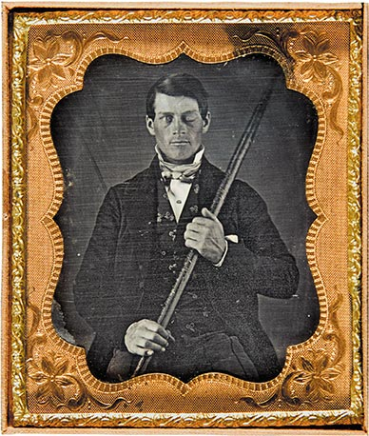
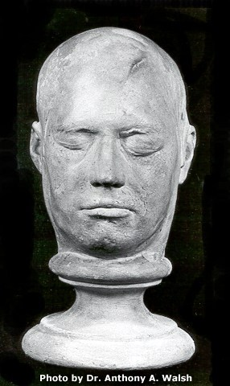
Phineas Gage
Image source: Smithsonian magazine, January 2010
Google image source: http://www.sruweb.com/~walsh/gage1.jpg
Notes:
How many of you have heard of Phineas Gage? This is a plaster mask of Phineas’ head, made in Boston after his accident. It shows exactly what the “recovered” Phineas looked like a year after his injury. Note the large scar on his upper forehead.
Here’s what happened:
September 13, 1848 Cavendish, Vermont 26 years old Phineas Gage was the foreman of a railroad track construction gang. His job was to supervise as explosives were used to blast solid rock into pieces small enough for his crew to dig loose with hand tools and to haul away in ox cars. First, a hole was drilled in the bedrock at exactly the right angle and depth. The bottom of the hole was then filled with gunpowder, and a ropelike fuse was carefully pressed down into the powder. The hole was then filled with loose sand. After sounding the warning, the fuse was lit, everyone ran for cover, and the explosion blasted the rock away. This time however, something went terribly wrong. The sand was inadvertently left out, and Phineas’s tamping iron was knocked- or fell- from his hand, falling directly into the hole onto the gunpowder, creating a spark that set off the explosion prematurely. The tamping iron was propelled upward like a bullet, piercing Phineas’ left cheek and exiting through the top of his forehead. Phineas survived and even remained conscious as he was transported to the local Doctor’s office. He was very ill for several months- contracting an infection that nearly killed him, but ultimately, Phineas made a full recovery. A full-recovery that enabled him to live and work… but that resulted in him being a different man.

Slide 22
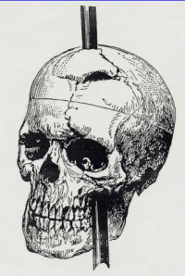
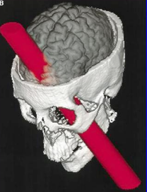
Phineas Gage: September 1848 Age 26
Google image source: http://www.brown.edu/Research/Memlab/py47/diagrams/phineas.jpg
Died: 1861
Notes:
September 13, 1848 Cavendish, Vermont 26 years old Phineas Gage was the foreman of a railroad track construction gang. His job was to supervise as explosives were used to blast solid rock into pieces small enough for his crew to dig loose with hand tools and to haul away in ox cars. First, a hole was drilled in the bedrock at exactly the right angle and depth. The bottom of the hole was then filled with gunpowder, and a ropelike fuse was carefully pressed down into the powder. The hole was then filled with loose sand. After sounding the warning, the fuse was lit, everyone ran for cover, and the explosion blasted the rock away. This time however, something went terribly wrong. The sand was inadvertently left out, and Phineas’s tamping iron was knocked- or fell- from his hand, falling directly into the hole onto the gunpowder, creating a spark that set off the explosion prematurely. The tamping iron was propelled upward like a bullet, piercing Phineas’ left cheek and exiting through the top of his forehead. Phineas survived and even remained conscious as he was transported to the local Doctor’s office. He was very ill for several months- contracting an infection that nearly killed him, but ultimately, Phineas made a full recovery. A full-recovery that enabled him to live and work… but that resulted in him being a different man.
Additional information (From book- Phineas Gage…) Phineas Gage was a young railroad construction supervisor in the Rutland and Burland Railroad site, in Vermont. In September 1848, while preparing a powder charge for blasting a rock, he inadvertently tamped a steel rod into the hole. The ensuing explosion projected the tamping rod, with 2.5 cm of diameter and more than one meter of length against his skull, at a high speed. The rod entered his head through his left cheek, destroyed his eye, traversed the frontal part of the brain, and left the top of the skull at the other side. Gage lost consciousness immediately and started to have convulsions. However, he recovered conscience moments later, and was taken to a local doctor, John Harlow, who took care of him. Amazingly, he was talking and could walk. He lost a lot of blood, but after a bout with infection, he not only survived the ghastly lesion, but recovered well, too.
Months later, however, Gage began to have startling changes in personality and mood. He became extravagant and anti-social, foul-mouthed and a liar with bad manners, and could no longer hold a job or plan his future. "Gage was no longer Gage", said his friends of him. He died in 1861, thirteen years after the accident, penniless and epileptic, and no autopsy was performed on his brain. His former physician, John Harlow, interviewed his friends and relatives, and wrote two articlew, reporting Gage's reconstructed medical history, one in 1948, entitled "Passage of an Iron Rod Through the Head", and another in 1868, titled "Recovery from the Passage of an Iron Rod Through the Head".
Phineas Gage became a classical case in the textbooks of neurology. The part of the brain which he had lost, was forever associated to the mental and emotional functions which he had lost. Harlow believed that, as he wrote, "The equilibrium between his intellectual faculties and animal propensities seems to have been destroyed.

Slide 23
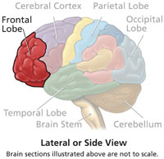

Slide 24
Before the accident…
Hard-working Respected Personable
Efficient Reliable Effective Responsible
After the accident…
Unreliable Irrational Impulsive
Disagreeable Difficult to get along with
Overly emotional Indecisive Foul-mouthed Anti-social Irresponsible
Notes:
Before the accident, Phineas had been a highly respected and hard-working man. He was well-liked by the men he supervised, was considered trust-worthy and responsible, and an expert at his job as foreman of a railroad construction crew.
After the accident, however, things changed. While he seemed to make a complete recovery, people who knew him well knew better. His doctor even wrote in his records that “Gage was no longer Gage.”
After the accident, Phineas had trouble holding down a job. He was difficult to get along with- nasty at times- and disagreeable. He flew into rages at the slightest provocation, was irrational, unreliable and acted irresponsibly. Phineas also became somewhat anti-social and extremely foul-mouthed and vulgar in his dealings with people. He bounced from job to job, ended up leaving his family and moving to South America where he worked as a stage coach driver for a time. Ultimately, in 1861- an epileptic, and penniless, Phineas Gage died- 13 years after his accident.
It was Phineas Gage’s misfortune that provided the first glimpse into the workings of the human brain- especially, the frontal lobes. Most people would have died as a result of the accident. Phineas lived, and became a classic example of the functions (or lack thereof) of the brain’s frontal lobes. Finally, scientists understood a little bit about what those two lobes- just behind the forehead- enable humans to do.

Slide 25
Two Types Of Mental Processes
Controlled (EF)
Thinking that takes effort
One at a time
Novel responses
More frontal lobes
e.g., planning a journey
Automatic
Thinking that happens without conscious control
In parallel
Well-rehearsed (routine)
All over the brain
e.g., steering, braking, reading the road
Notes:
2 types of mental processes taking place in brain at same time
Impossible to keep track of everything – most mental processes happen automatically

Slide 26
Basic Neurological Functions ‘What Happens Now’
Physiological functions
Sensory functions
Speech/language
Spatial
Motor
Memory of skills
Memory of facts

Slide 27
Basic Executive Functions – ‘How and When’
Round A composition for two or more voices in which each voice enters at a different time with the same melody
Row, row, row your boat
Gently down the stream
Merrily, merrily, merrily
Life is but a dream
Notes:
The self-regulation and organization of behavior across time to anticipate and prepare for the likely social future and to pursue one’s goals (self-interests) often in concert with others
The EF system most likely evolved to serve social functions in a group-living species (humans) that engages in reciprocity, trade, cooperation, coalition formation, and social competition

Slide 28
What Are Executive Functions (EFs)?
Umbrella term for neurologically-based skills involving mental control & self-regulation
Purposeful and thoughtful directive capacities of the brain that cue the use of perceptions, thoughts, actions, & emotions
Allow us to be mentally & behaviorally flexible, to adjust thinking & strategies & to adapt our responses
Executive function is the ability to integrate a present awareness with future anticipation and past experience to develop a reasonable plan (accounting for space, time and people) for present action
Notes:
Multiple in nature, not a single capacity
Part of neural circuits that are routed through the frontal lobes
Cue the use of other mental abilities
Direct and control perceptions, thoughts, actions, and, to some degree, emotions
*Most needed when the routine for the task is not well developed
High order cognitive skills associated with the ability to engage in independent, goal-directed behavior
Draw on fundamental skills to generate higher levels of creative and abstract thought

Slide 29
What Do We Know About EF?
Function of the frontal lobe (prefrontal cortex)
Neural circuits wire and route how we think and function
Can operate on a nonconscious as well as conscious level, but all
executive capacities can be consciously engaged
High degree of variability depending on the specific domain of functioning
that is being directed: sensation, perception, emotion, cognition, or action
Air Traffic Controller Co-conductors of Orchestra Brain Boss

Slide 30
How Do EFs Develop?
Developing from the first years of life well into adulthood
Strongly influenced by experience, teaching, environmental expectations
Large developmental shifts are noticeable
Natural maturational delays and lags are observed
Cultural change points (e.g., educational transitions) serve to highlight EF deficits
Not an implicit process – learned through explicit experiences and practice
Good executive control in one domain does not guarantee good executive control in the other domains. Poor control in one domain does not guarantee poor control in the other domains.
Notes:
Maturation of Executive Functions:
A maturational spurt from 17 to 25 years (frontal lobes don’t mature until age 25 or more)
For some continues into the early 30’s
Lastly, myleinization completed from 40 to 50’s (growth in myelin on axon; better conduction of electrical impulses
Intraindividually, all EFs do not develop evenly. For any given individual, one EF can be more or less developed than any other EF at any given point in time.
Interindividually, there is also great variation relative to chronological age. At the same age, different individuals will naturally vary considerably in their level of development of various EFs.
When assessing EF deficits need to figure out if they’re the result of:
Disuse through Conscious Choice,
Disuse through Unconscious Choice,
Maturational Delay, or
Innate Deficiency?

Slide 31
Rey’s Complex Figure Drawing

Slide 32
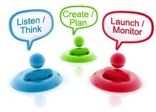
What Are the EF Clusters?
Activation | Organizing, prioritizing & activating to work
Focus | Focusing, sustaining, & shifting attention to tasks
Effort | Regulating alertness, sustaining effort & processing speed
Emotion | Managing frustration & regulating emotions
Memory | Utilizing working memory & accessing recall
Action | Monitoring & self-regulating action

Slide 33
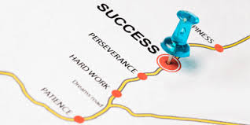
Planning/Prioritizing
Ability to create a roadmap to reach a goal or to complete a task
Involves being able to make decisions about what’s important to focus on and what’s not important
How do I go about doing this task?

Slide 34
In performing an experiment like this one on man attention car it house is boy critically hat important shoe that candy the man material car that house is boy being hat read shoe by candy the man subject car for house the boy relevant hat task shoe be candy cohesive man and car grammatically house correct boy but hat without shoe either candy being man so car easy house that boy full hat attention shoe is candy not man required car in house order boy to hat read shoe nor too difficult.
Notes:
Read only the bold words. What was the gist of the paragraph? Point: Just like at a cocktail party, your brain was able to block out extraneous stimuli, in order to focus on the task at hand.

Slide 35
15 year old brain does not have the biological machinery to inhibit impulses in the service of long-range planning
One reason teens can “flip out” with a moment’s notice
“Adolescents make a lot of decisions that the average 9 yr. old would say [were] a dumb thing to do.”
Ronald E. Dahl, MD, Univ. of Pittsburgh Medical Center, NYAS Magazine 2003

Slide 36
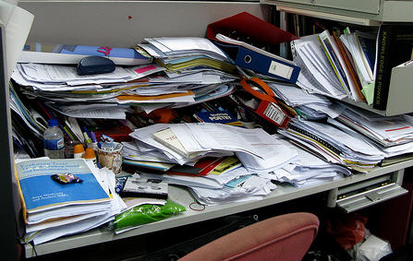
Organization
Ability to design and maintain systems for keeping track of information or materials
Where does my stuff go?

Slide 37
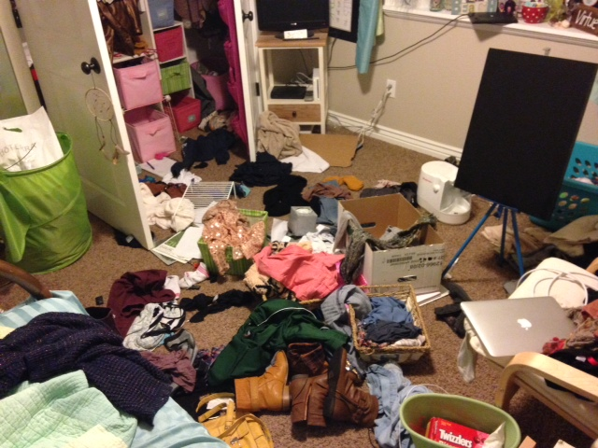
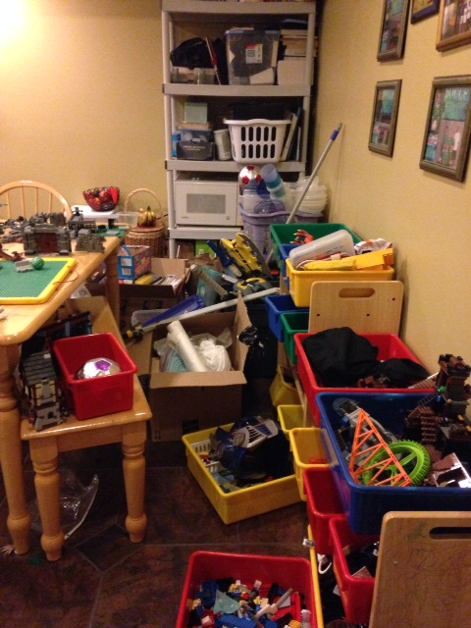
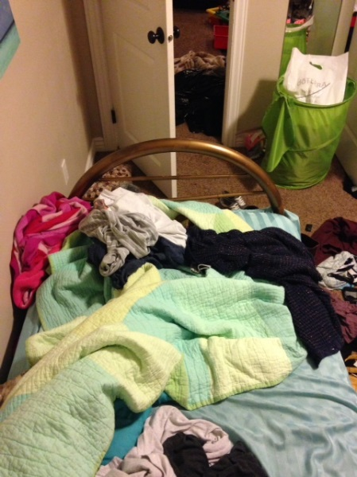
Look Familiar?

Slide 38
Time Management
Capacity to estimate how much time one has, how to allocate it and how to stay within time limits and deadlines
Involves a sense that time is important
How much time do I need?

Slide 39
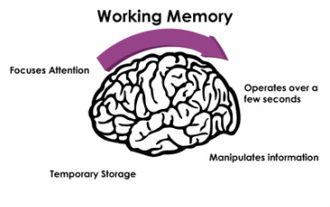
Working Memory
Ability to hold information in mind while performing complex tasks
Incorporates the ability to draw on past learning or experience to apply to the situation at hand or to project into the future
What do I have to remember?
Notes:
Nonverbal WM enables:
hindsight, foresight, Mental representations
Pattern recognition, Sense of time and events in time
Verbal WM enables:
Holds language ‘on-line’ while processing, manipulating or waiting
Self-talk, Rule-governed behavior/reasoning
Limited capacity, ‘budget problem’, Easily overwhelmed or overwritten
May do task components in isolation but not simultaneously ‘forget to remember’
Timing and timeliness of access, Need for contingent, convergent, coordinated retrieval
Impacts math, writing, reading comprehension and time
management
Productivity, accuracy and behavior will vary with volume,
complexity and/or level of adult support and structure
Chronic difficulty holding and processing current information results in
Difficulty holding onto relevant thoughts in order to express them in discussions
Interrupting others due to fear of losing a thought
Difficulty recalling information in test situations
Reading comprehension gaps
Difficulty with writing tasks

Slide 40
Memory Space
15
13
*Mental Age
11
9
*Plus or Minus 2
7
5

Slide 41
Limitations of working memory…
The Cocktail Party Effect
The brain is usually able to block out competing stimuli, in order to focus on the task at hand but not always
Notes:
Working Memory has several limitations that teachers need to be aware of- this awareness will help teachers in thinking critically about what they are asking students to do… and how they are asking students to do it… and will orchestrate activities and the environment in a way that is consistent with how working memory works---- thus increasing students’ chances for success.
Examples:
Readings at Church
Traffic or bad roads or construction, unconsciously turn down radio
CNN- scrolling…
Talking on cell phone while driving…. Or while shopping- or walking---- in a “zone” don’t notice other things, people- almost trance-like
Multi-tasking… Toggling back and forth… lose continuity… completion of task takes longer…. May not be of as high a quality.

Slide 42
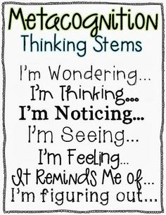
Metacognition
Ability to stand back and take a bird’s-eye view of oneself in a situation
Ability to observe how you problem solve and use self-monitoring and self-evaluative skills
How well am I doing here?
How’s this working for me?

Slide 43
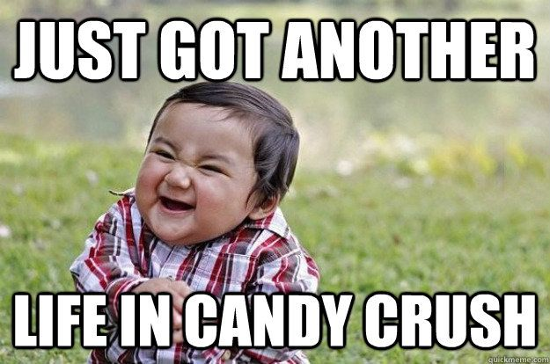
Puzzles Prime the Brain for Problem Solving When encountering a mental block, take a brain break and focus on a puzzle or word game. Puzzles, word games and brain teasers stimulate activity in the frontal lobe and right hemisphere, making neural connections more flexible for future problem solving.

Slide 44
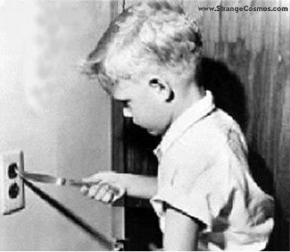
Response Inhibition
Capacity to think before acting
Ability to resist the urge to say or do something
Allows us the time to evaluate a situation and
how our behavior might impact it
Can I control my impulses?
Notes:
Impaired ability to self-regulate results in
Inappropriate comments in social situations
Inability to monitor how others perceive them
Difficulty slowing down
Difficulty following directions
Impulsive acts

Slide 45
YELLOW BLUE ORANGE BLACK RED GREEN PURPLE YELLOW RED ORANGE GREEN BLACK BLUE RED PURPLE GREEN BLUE ORANGE

Slide 46
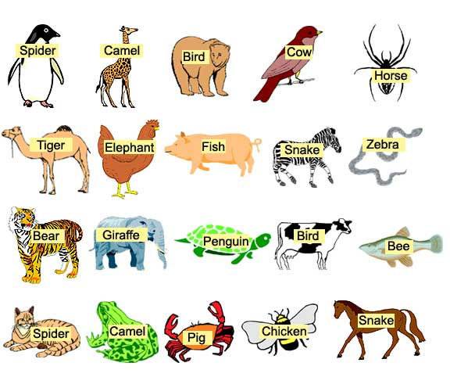

Slide 47
Emotional Control
Self-regulation of affect
Ability to manage emotions in order to achieve
goals, complete tasks or control and direct behavior
Can I control my emotions?
Notes:
Low threshold for frustration results in
Irritability
Angry outbursts
Inability to accept another’s point of view
Constant arguing
Difficulty regulating emotions results in
Insensitivity to others
Disproportionate emotional response to the comments or actions of others
Moodiness

Slide 48
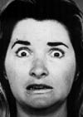
What emotion is this woman expressing?

Slide 49
HOT AND COLD COGNITION
Thoughts and emotions are intertwined – adolescents need to develop a balance between cognitive and affective systems of the brain
COLD cognition refers to thinking under conditions of low emotions and/or arousal
HOT cognition refers to thinking under conditions of strong feelings or arousal
Decisions made under conditions of strong affect are difficult to influence by cool rational thought alone

Slide 50
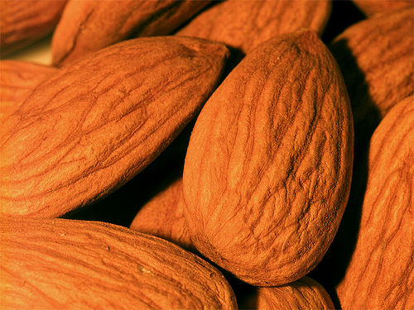
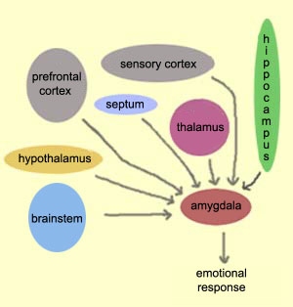
All roads lead to the amygdala
Cortical Pathway
cognitive connections with amygdala
High and slow
Stop and think before reacting
High road processing – rational, controlled
Thalamic Pathway
lower order connections with amygdala
Low and fast
Shoot first and ask questions later
Low road processing – automatic, prepotent, initiated by amygdala

Slide 51
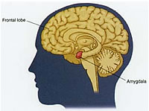
Amygdala Hijack
Like any skilled air traffic controller, the thalamus can quickly react to potential threat. In that case, it bypasses the cortex -- the thinking brain -- and the signal goes straight to the amygdala. The amygdala can only react based on previously stored patterns.
thalamus

Slide 52
Manifestations of ‘Low Road’ Emotional Processing
Limited frustration tolerance
Limited adaptability (these youth become easily ‘stuck’)
Limited alternate thinking skills (small problem solving repertoire)
Reflexive negativity
In a nutshell, EFD students become easily
swamped by their emotions

Slide 53
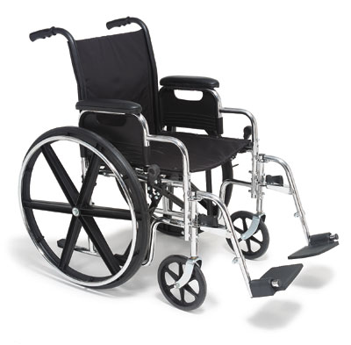
It’s helpful to think of these kids as being in a ‘cognitive wheelchair.’ Ross Greene
Amygdala
It’s also helpful to think of these youth as manifesting a clear mismatch in power between a very strong emotion-generation center of the brain and less developed emotion regulation center
Orbital PFC

Slide 54
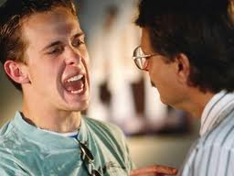
Responding effectively to ‘amygdala hijacks’
Approach low and slow!!
Stay nearby, but say little (raging amygdala makes lousy conversational partner)
First change the body, then change the mind (or ‘first walk, then talk’)

Slide 55
Sustained Attention
Capacity to attend to a situation or task
in spite of distractibility, fatigue or boredom
Can I attend to something I may or
may not be interested in?
Notes:
Difficulty sustaining attention results in:
Papers and projects that have inconsistent quality due to inconsistent focus
Distractions that pull attention away from learning
Gaps in learning due to inconsistent attention to readings, lectures, assignments
Difficulty shifting attention results in:
Inconsistent performance from course to course
Inconsistent quality within assignments that require multiple steps to complete

Slide 56
The Brain’s Attention Networks
Maintaining alertness
I’m ready!
Focusing visual & auditory stimuli
Where you look & what you listen to Zoom in!
Executive attention
Inhibiting competing thoughts, emotions, stimuli to complete a task Ignore distractions!

Slide 57
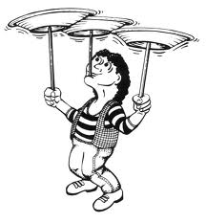
What about multitasking?
Toggling (task-switching)
Paying ‘continuous partial attention’
Quality decreases on both (or all) tasks attempted
Time to complete tasks increases when attempting to multitask

Slide 59
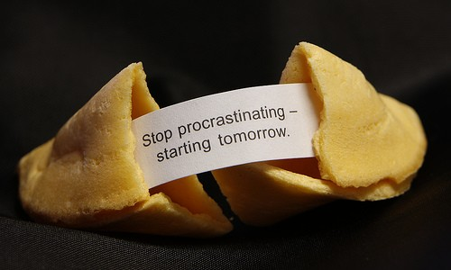
Task Initiation
Ability to begin a task without undue procrastination, in a timely fashion
Can I get started on my own?

Slide 60
Flexibility
Ability to revise plans in the face of obstacles, setbacks, new information, or mistakes
Involves adaptability to changing conditions
Can I change and adapt?

Slide 61
Goal-Directed Persistence
Capacity or drive to follow through to the completion of a goal and not be put off by other demands or competing interests
Can I complete this task within a deadline?
Notes:
Difficulty sustaining effort and alertness results in:
Incomplete assignments
Poor study habits
Frequent drowsiness when not engaged
Poor sleep hygiene, even for college students
Apparent lack of motivation
Slow Processing results in:
Excessive time to complete tasks
Poor written output

Slide 62
Barkley’s EF Deficit Model
Difficulty in development of:
Mind’s Eye - Picture of Self (don’t use imagery)
Mind’s Voice - Self Speech (don’t talk to self well)
Mind’s Heart - Manage Emotion (don’t regulate feelings)
Mind’s Playground - Mental Play (poor planning & problem-solving)

Slide 63
What Are The 5 EFs In Major Life Activities?
Self-Discipline (Inhibition)
Cognitive, behavioral, verbal, emotional
Self-Management to Time
Consideration of past and future consequences before acting;
managing self relative to time and deadlines
Self-Organization & Problem-Solving
Innovating, planning possible response options, problem-solving to overcome
obstacles to goals, rapid assembly and performance of novel goal-directed behavior
Self-Motivation
Substituting positive goal-supporting emotions for negative goal-destructive ones
Self-Activation & Concentration

Slide 64
What Efs Are Activated?
How did you get here today on time?
What would have happened if 18th Street was closed due to construction?
Your family wants to eat dinner at 7 and you’re the cook: How do you get the food on the table in time?
Someone cuts you off in a traffic lane: What keeps you from yelling “#**#!%”?
The clock is ticking loudly in the den where you are reading a book, but you don’t hear it. Why?
You walk into a funeral service and immediately begin speaking in a whisper. Why?
You accidentally bump into someone and apologize. Why?

Slide 65
What Is The Production Paradox?
The neural circuits for executive function activation are routed differently depending on whether the activation is based on an internally driven desire or command versus an external demand
Because internally driven production is much easier to accomplish than externally demanded production for children with “producing difficulties” their lack of production on demand often stands in stark contrast to their seemingly effortless production “when the spirit moves them”
The on-demand deficiencies observed by others are often attributed to negative personal characteristics such as lack of responsibility, apathy, passive aggressive stance, or oppositional defiance

Slide 66
Self-Directed Drawing

Slide 67
Recall After 3 Minutes

Slide 68
Self-Generated Free Hand Drawing

Slide 69
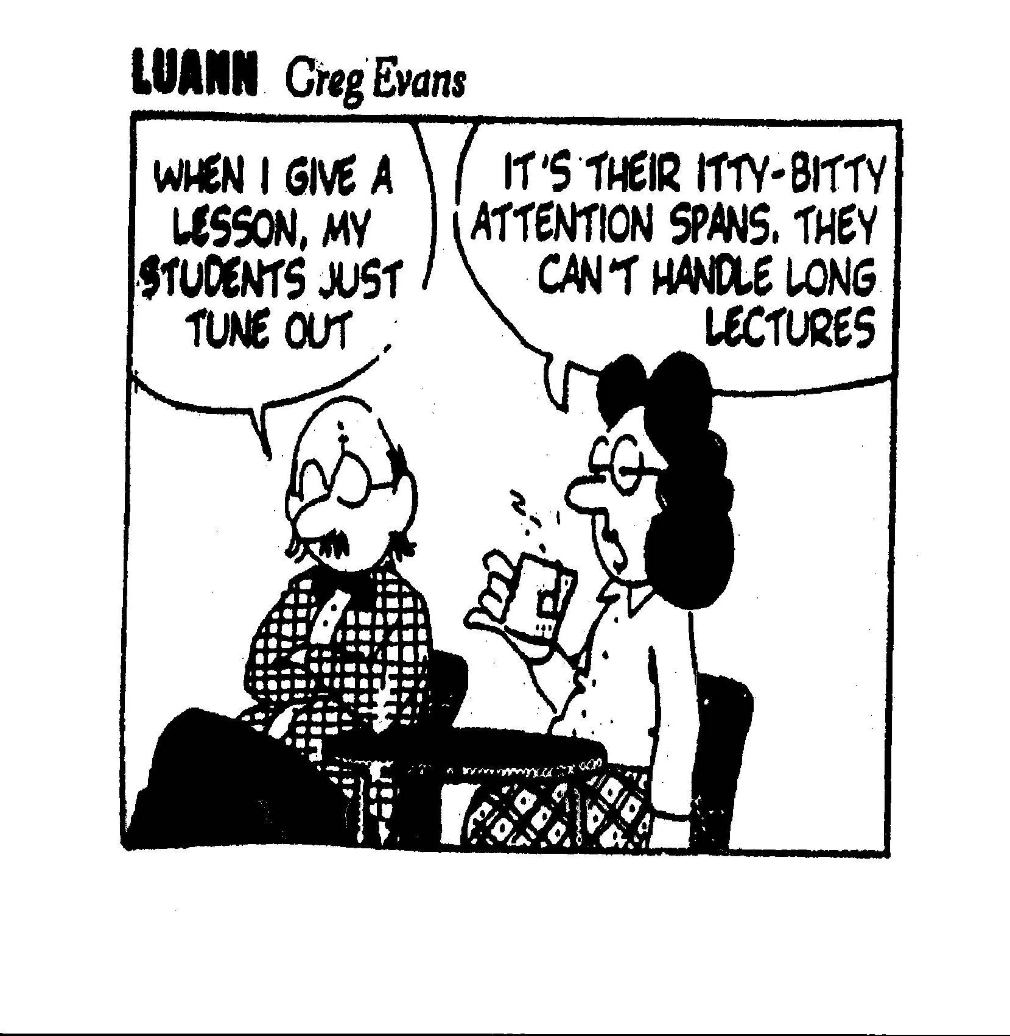
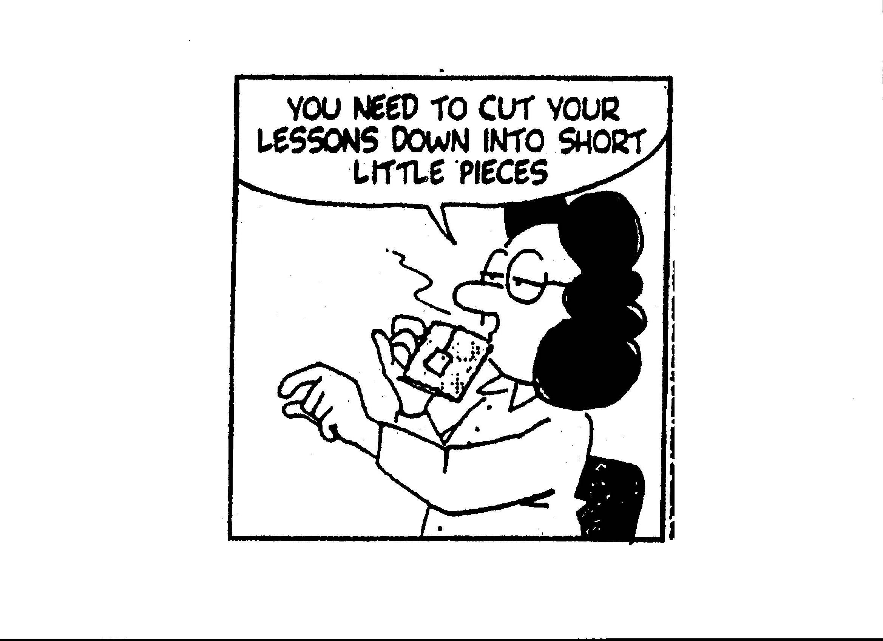

Slide 70
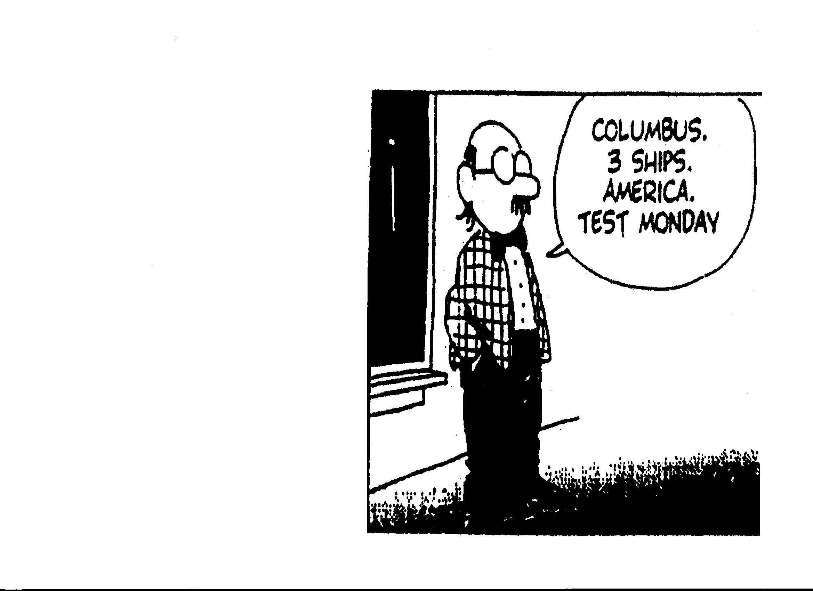

Slide 71
“As it turns out, teenagers may, indeed, be a bit crazy. But they are crazy according to a primal blueprint. They are crazy by design.”
Barbara Strauch, The Primal Teen
Notes:
Quote: “As it turns out, teenagers may indeed, be a bit crazy. But they are crazy according to a primal blueprint. They are crazy by design.”
This quote was taken from one of my favorite “brain books”, The Primal Teen: What the New Discoveries about the Teenage Brain Tell us About our Kids, by Barbara Strauch. This book, which is very readable- not overly technical- does an excellent job of explaining exactly what is going on inside the heads of adolescents. What neuroscientists and psychologists have discovered is nothing less than astounding… and has pretty much turned the world of neuroscience on its ear- disproving assumptions about the brain that have been held as fact for many years. This new information is truly NEW- the research studies that led to our new understanding were reported for the first time in 1999 and continue today, almost as a new “field” of neuroscience- the study of the adolescent brain.

Slide 72
http://www.math.harvard.edu/~knill/mathmovies/m4v/inthenavy_28.m4v

